Slide 1
DEVELOPMENT OF A DYNAMIC CURRENCY MANAGEMENT WEB APPLICATION: A COMPREHENSIVE FRONT-END AND BACK-END INTEGRATION
https://github.com/roshanmaandiya/Web-Development-DLBCSPJWD01-

Slide 2
PURPOSE OF THE WEB APPLICATION
This web application focuses on the management of currency rates
The application will produce existing rates, and a new data input will be taken without interruption to view all the rates.
Different technologies and frameworks have been used for the creation of this project to design an interactive interface and a powerful backend system.
Notes:
This web application focuses on the management of currency rates. The application will produce existing rates, and a new data input will be taken without interruption to view all the rates. Different technologies and frameworks have been used for the creation of this project to design an interactive interface and a powerful backend system.

Slide 3
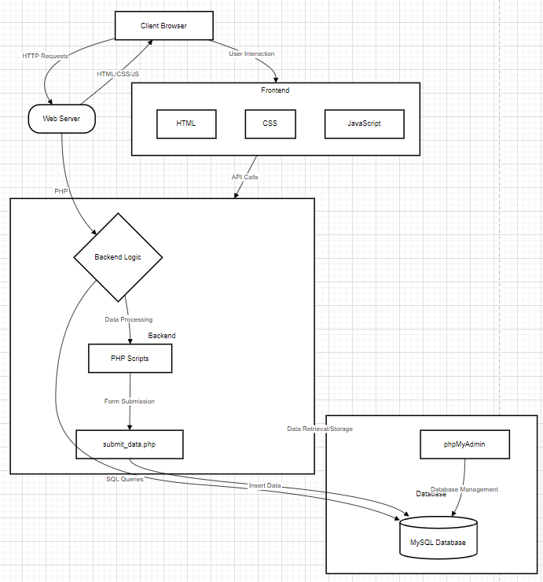
ARCHITECTURE DIAGRAM OF THE DEVELOPED WEBPAGE
Notes:
This web application focuses on the management of currency rates. The application will produce existing rates, and a new data input will be taken without interruption to view all the rates. Different technologies and frameworks have been used for the creation of this project to design an interactive interface and a powerful backend system.

Slide 4
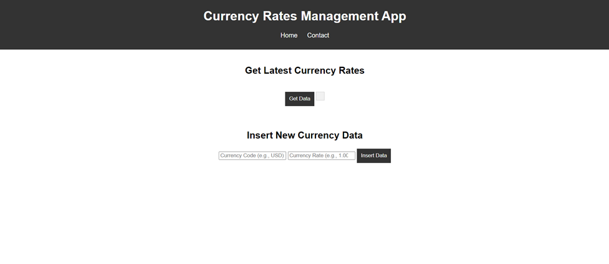
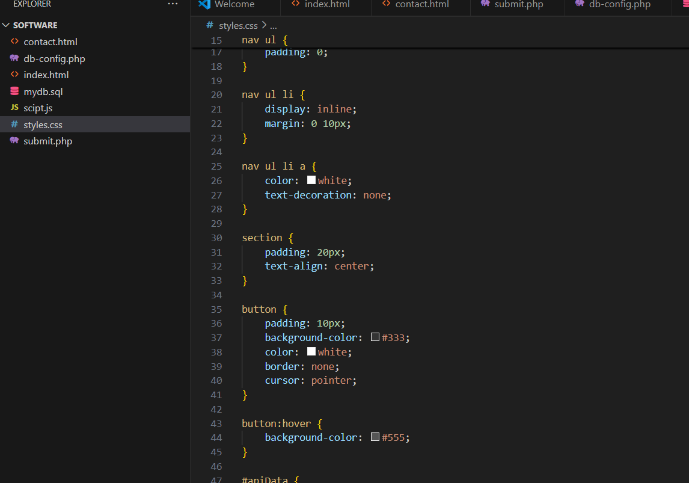
Technologies used: Front End Development
The front end of the web application has been developed using HTML, CSS, and JavaScript.
The HTML structure has created the basic structure of the application with different areas for displaying current currency rates and a form to insert new currency data.
CSS is applied in styling the application, offering it an excellent view and ensuring that the user has an advantage when it comes to its efficient usability
The currency rates have been hardcoded into the script, and on click of the "Get Data" button, users can fetch and display the latest rates using JavaScript.
Notes:
The front end of the web application has been developed using HTML, CSS, and JavaScript. The HTML structure has created the basic structure of the application with different areas for displaying current currency rates and a form to insert new currency data. The user interface of the application is quite intuitive and easy to navigate. As for style, CSS is applied in styling the application, offering it an excellent view and ensuring that the user has an advantage when it comes to its efficient usability (Odeniran, 2023). The design focused on responsibility to ensure that the application fits well with different sizes of screens and devices. JavaScript: This has been very important in the dynamic aspects of the application. The currency rates have been hardcoded into the script, and on click of the "Get Data" button, users can fetch and display the latest rates.

Slide 5
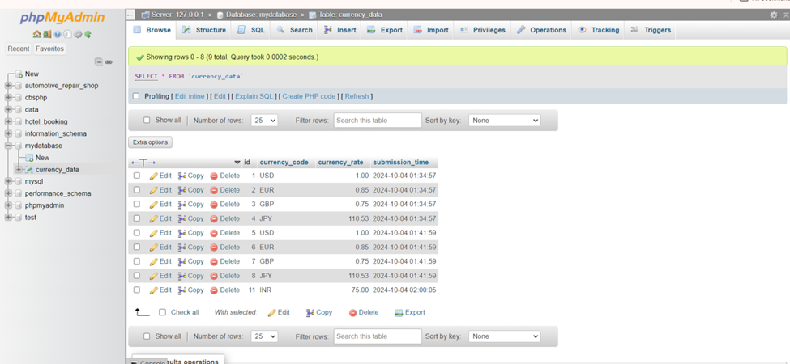
Technologies used: Back-end Development
PHP was used at the back end to catch the form submission from the front end, with a structured approach toward addressing user input for proper new currency rate handling and storage in a MySQL database.
Designed a PHP file specifically to handle form submission “submit_data.php”
It involved adding validation checks to ensure that the submitted currency code and rate go through proper formatting before being inserted into the database
Notes:
PHP was used at the back end to catch the form submission from the front end, with a structured approach toward addressing user input for proper new currency rate handling and storage in a MySQL database. The PHP script has created an active connection with the database making use of my sql extension, ensuring secure interaction with the database. Designed a PHP file specifically to handle form submission - `submit_data.php`. It involved adding validation checks to ensure that the submitted currency code and rate go through proper formatting before being inserted into the database (Goh et al., 2023). The approach of prepared statements prevent SQL injection attacks.

Slide 6
Database Management
The database has been administered using phpMyAdmin, it's easy to administer the data.
The structure has been created via SQL script, defining the involved tables and columns thereof.
Using this configuration made the administration of the data straightforward and ensured that all records were well-kept.
Notes:
The database has been administered using phpMyAdmin, it's easy to administer the data. The structure has been created via SQL script, defining the involved tables and columns thereof (Baidauletov, and Salehin, 2020). Using this configuration made the administration of the data straightforward and ensured that all records were well-kept.

Slide 7
Conclusion
The web application has successfully combined front-end and back-end technologies to offer fluent functionality for managing currency rates.
This application has enabled users to enter and view currency data easily, therefore ensuring that it is securely processed and stored.
The application not only completes the purpose but also establishes a base for possible further improvements and features in the future.
Notes:
The web application has successfully combined front-end and back-end technologies to offer fluent functionality for managing currency rates. This application has enabled users to enter and view currency data easily, therefore ensuring that it is securely processed and stored. Such successful implementation demonstrates good practice in web development and delivers practical tools for accessing currency information efficiently to users. The application not only completes the purpose but also establishes a base for possible further improvements and features in the future.

Slide 8

Screencast

Slide 9
Reference List
Odeniran, Q., 2023. Comparative Analysis of Fullstack Development Technologies: Frontend, Backend and Database. Retrieved from: https://digitalcommons.georgiasouthern.edu/cgi/viewcontent.cgi?article=3883&context=etd [Retrieved on: 25.09.2024]
Goh, H.A., Ho, C.K. and Abas, F.S., 2023. Front-end deep learning web apps development and deployment: a review. Applied Intelligence, 53(12), pp.15923-15945. Retrieved from: https://link.springer.com/article/10.1007/s10489-022-04278-6 [Retrieved on: 25.09.2024]
Baidauletov, D. and Salehin, F., 2020. Integrating Modern Front-end Methodologies and Workflow in the Context of E-commerce Systems. Retrieved from: https://www.theseus.fi/bitstream/handle/10024/334447/Baidauletov%20D.%20%26%20Salehin%20F.%20-%20Integrating%20Modern%20Front-End%20Methodologies%20and%20Workflow%20in%20the%20Context%20of%20E-Commerce.pdf?sequence=2 [Retrieved on: 25.09.2024]
Notes:
Odeniran, Q., 2023. Comparative Analysis of Fullstack Development Technologies: Frontend, Backend and Database. Retrieved from: https://digitalcommons.georgiasouthern.edu/cgi/viewcontent.cgi?article=3883&context=etd [Retrieved on: 25.09.2024]
Goh, H.A., Ho, C.K. and Abas, F.S., 2023. Front-end deep learning web apps development and deployment: a review. Applied Intelligence, 53(12), pp.15923-15945. Retrieved from: https://link.springer.com/article/10.1007/s10489-022-04278-6 [Retrieved on: 25.09.2024]
Baidauletov, D. and Salehin, F., 2020. Integrating Modern Front-end Methodologies and Workflow in the Context of E-commerce Systems. Retrieved from: https://www.theseus.fi/bitstream/handle/10024/334447/Baidauletov%20D.%20%26%20Salehin%20F.%20-%20Integrating%20Modern%20Front-End%20Methodologies%20and%20Workflow%20in%20the%20Context%20of%20E-Commerce.pdf?sequence=2 [Retrieved on: 25.09.2024]

Slide 10


